Slide 1
2. Binary image coding
Yi-Shin Tung
National Taiwan University

Slide 2
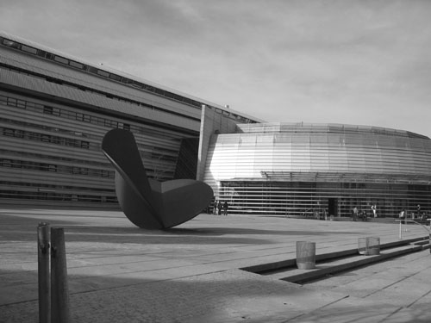
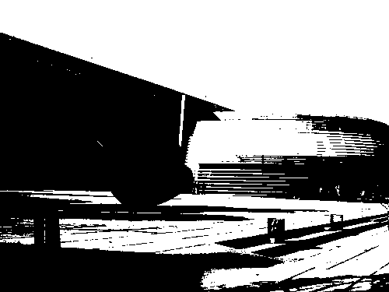
Digital bi-level image
Properties
  Only foreground (black) and background (white) colors
  High contrast
  High resolution (above 200dpi)
  Contain texts, halftone images, and line art
Grayscale (multi-level)
Black white (bi-level)

Slide 3
Concepts behind fax coding
Evolution Process
  Proprietary methods
  Analog Standards (G1 and G2)
  Digital Standards (G3 and G4)
  More recent JBIG1 Standard
  Latest JBIG2 Standard
Property of Fax Coding
  Most of the info is highly correlated across scan lines (as well as between scan lines).
  Scan process proceeds sequentially from top to bottom (a line at a time) in a left to right fashion.
  Simplicity, high speed, low memory requirement and high error robust.

Slide 4
ITU-T T.4/T.6 (Group 3 and 4)
ITU-T T.4: Standardization of Group 3 facsimile terminals for document transmission
ITU-T T.6: Facsimile coding schemes and coding control functions for group 4 facsimile apparatus

Slide 5
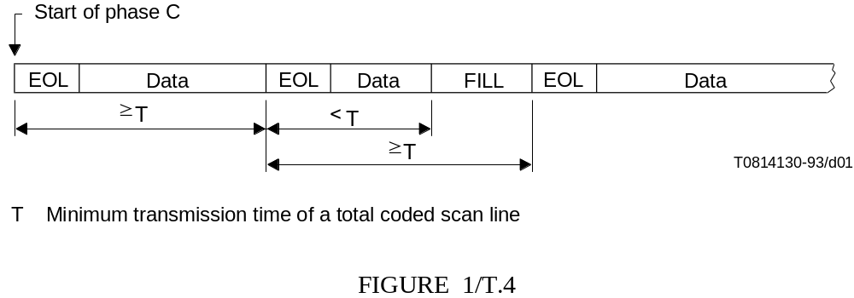
G3 Standard: 1D coding scheme
Resolution: vertical 3.85 (7.7) lines/mm, horizontal 200 dpi
Using two static Huffman Tables for black and white pixels.
Split Run to 64N + R, (0 ≤ R < 64)
If N = 0, send R (Terminating codes) only
If N !=0, send N (Make-up codes), R
Different tables for white and black pixels, respectively.
Minimum transmission time should be strictly kept. That is to say, data length in a line must be greater than Minimum Line Length.
  Example: In 4800 bps, 96 bits a line is needed (padding 0) for sync.
  Special “Fill” symbol for pause.
(20msec)

Slide 6
Modified Huffman Codes (MH)
G3 (1-D)
Perform one-dimensional coding on run-length pair to encode 1728 pixels (215 mm) of each line
Clever codes for EOL, EOP, and for regular synchronization between the encoder and decoder.
20-to-1 compression on simple text documents.
(111111111111100000000000000001111111110000000000111111111EOL)
RLE
(1,13) (0,16) (1,9) (0,10) (1,9) EOL
Bi-level RLE
0,13,16,9,10,9,EOL
Huffman Code
00110101000001001010100
00010010100000000000001
EOL
Data
EOL
Data
EOL
Data
EOL
...
...
EOL
EOL
EOL
EOL
EOL
EOL
EOP

Slide 7
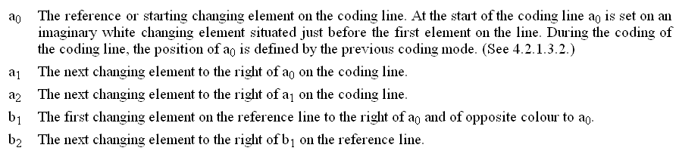
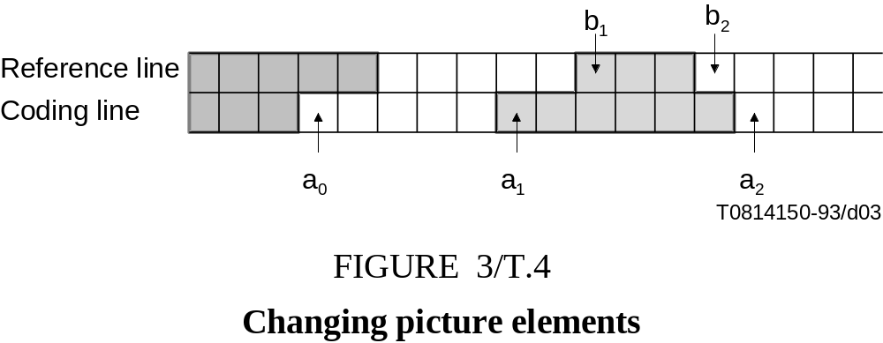
G3 Standard: 2D coding scheme
K-1 2D-coded lines followed by one 1D-coded line.
  K=2 or 4
Changing element
Special uncompressed mode

Slide 8
Modified READ coding (MREAD)
G3 (2-D)
MREAD (Relative Element Address Designate) provides an improvement over MH by using a two-dimensional coding scheme, which takes advantage of vertical spatial redundancy as well as horizontal spatial redundancy.
3 modes can be selected.
25-to-1 compression, a 25% improvement over MH encoding.
b1
b2
Pass Mode: essentially defers the encoding decision until more of the scan line is examined.
a0
a1
a2
b1
b2
P=0001_{b}
Vertical Mode: coding based on previous scan line.
a0
a1
a2
V(a₁b₁)
b1
b2
Horizontal Mode: locally along the scan line.
a0
a1
a2
H+M(a₀a₁) +M(a₁a₂)

Slide 9
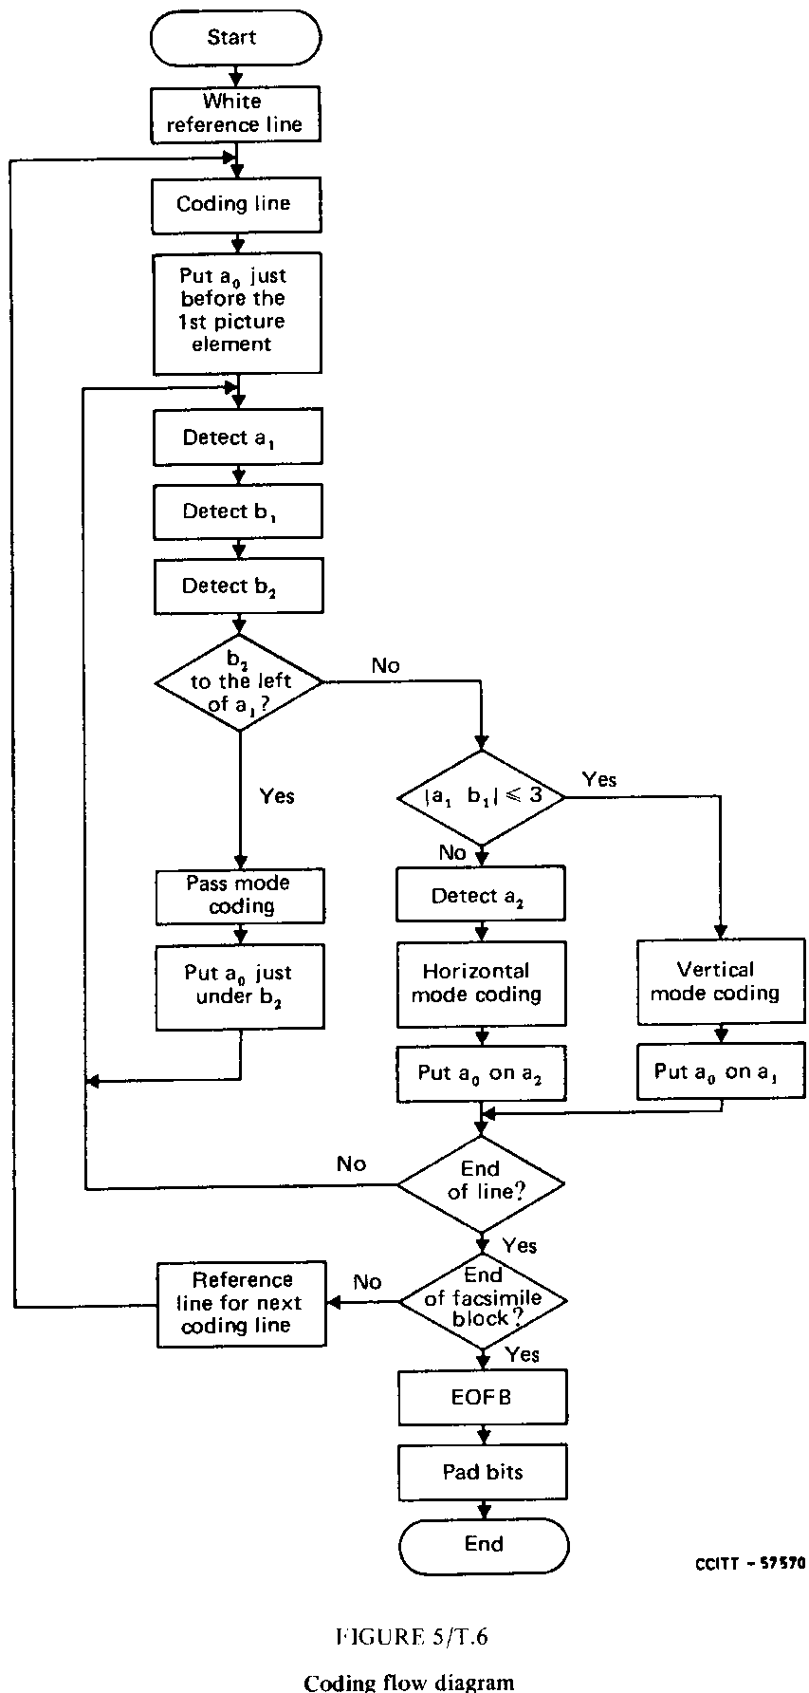
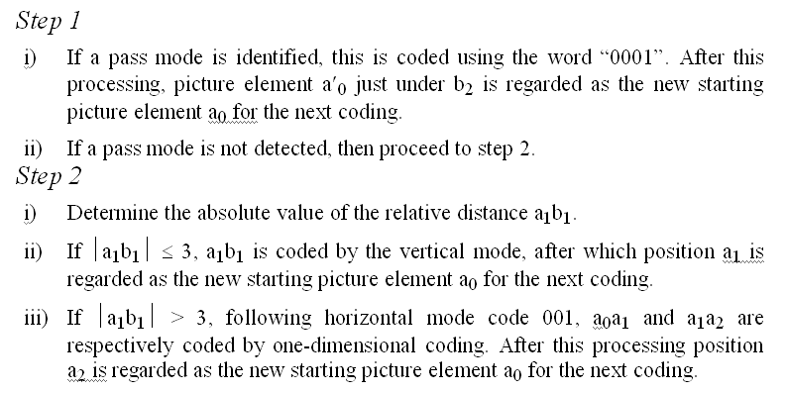
Encoding flow diagram

Slide 10
G4 modified modified READ coding (MMR)
Assume an error free transmission medium
K is infinite.
No EOL symbols are coded.

Slide 11
JBIG
JBIG is short for the 'Joint Bi-level Image experts Group'.
The official page: http://www.jbig.org.
The 'official' title of the committee is ‘ISO/IEC JTC1 SC29 Working Group 1’.

Slide 12
Organization
ISO
IEC
International
Organization for
Standardization
International
Electrotechnical
Commission
ISO/IEC JTC1
ISO/IEC Joint Technical Committee
SC1
SC :Sub Committee
WG :Working Group
JPEG :Joint Photographic
Coding Experts Group
MHEG :Multimedia and Hypermedia
Information Coding Experts Group
MPEG :Moving Picture Experts Group
SC2
WG1(JPEG, JBIG)
SC29
WG11(MPEG)
Multimedia
Coding Area
WG12(MHEG)

Slide 13
ISO/IEC 11544 (ITU-T T.82)
Information technology – Coded representation of picture and audio information – Progressive bi-level image Compression
Phase 0
Phase 1
Phase 2
Phase 3

Slide 14
JBIG
MREAD is adequate for text-based docs, but not provide good compression/quality for docs with handwritten text or continuous tone image.
The key idea is that for binary halftone images (i.e., continuous-tone images converting to dot patterns), neither MR nor MREAD is adequate since each image pixel needs a significantly larger region of support for prediction than that needed for text images.
Two compression mode: sequential mode and progressive mode.
JBIG1 provides compression rates that are slightly better (1.1~1.5x) than MREAD for text sequences, and an improvement by a factor of up to 8-to-1 (2~30x) for binary halftone images.

Slide 15
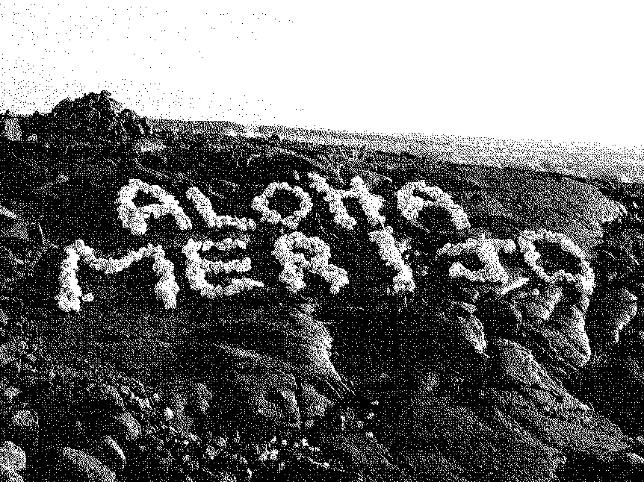
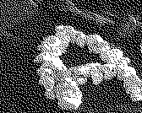
Features of JBIG
Dec Gray Binary
0 000 000
1 001 001
2 011 010
3 010 011
4 110 100
5 111 101
6 101 110
7 100 111
Lossless coding
Ability of providing progressive coder
Ability of compress binary image and greyscale or color image via bit-plane overlay (gray code)
Ability of good performance on binary halftone image
Halftone image

Slide 16
Coding Mechanism in JBIG
Data Partitioning
Resolution Reduction
Deterministic Prediction
Typical Prediction
Model Template
Adaptive Template
Adaptive Arithmetic Coding

Slide 17
Data Partitioning JBIG encoder
Stripe 0
S : Stripe Number
L₀: In R0, # of lines in a stripe
d : # of Resolution layers
Y_{d}: Stripe width in layer d
Stripe 1
Stripe 2
Stripe 3
...
Stripe S-1

Slide 18
Flowchart JBIG encoder
Resolution
Reduction
&
Differential
Layer
Encoder
Resolution
Reduction
&
Differential
Layer
Encoder
Lowest
Layer
Encoder
Full Sized
Image
Base Layer
Bitstream
Layer d
Bitstream

Slide 19
Flowchart JBIG encoder
Differential Layer
ATMOVE
I_{s,d}
Resolution
Reduction
I_{s,d-1}
Adaptive
Arithmetic
Encoder
C_{s,d}
Typical
Prediction
Deterministic
Prediction
Adaptive
Templates
Model
Templates
LNTP
TPVALUE
DPVALUE

Slide 20
Flowchart JBIG encoder
Lowest Layer
ATMOVE
I_{s,0}
Typical
Prediction
Adaptive
Templates
Model
Templates
Adaptive
Arithmetic
Encoder
C_{s,0}
SLNTP
TPVALUE

Slide 21
Resolution Reduction JBIG encoder
PRES (Progressive Reduction Standard)
Via the weighting filter, get the low resolution value
There are 574 exceptions.
  Edge preservation (132)
  Line preservation (420)
  Periodic pattern preservation (10)
  Dither pattern preservation (12)
Use Table Lookup to get corresponding sub-sampled value.
l₀₀
l₀₁
h₁₁
h₁₂
h₁₃
h₂₁
h₂₂
h₂₃
l₁₀
l₁₁
h₃₁
h₃₂
h₃₃
-1
-3
1
2
1
2
4
2
-3
?
1
2
1

Slide 22
Typical Prediction JBIG encoder
Differential-Layer
A low resolution pixel is “not typical” if it and all 8 neighboring pixels are the same color, but one or more of high resolution pixels differs from the common color.
Determine the line if it is typical, and add a pseudo pixel to express that.
Pseudo pixels
Not typical
Reused context for
pseudo pixels
LNTP
...
F
LNTP
F
F
F
...
B
B
F
F
?
LNTP
...
B
B

Slide 23

Typical Prediction JBIG encoder
Lowest Layer
Reused context for
pseudo pixels
Pseudo pixels
SLNTP
B
B
F
F
F
B
B
F
SLNTP
B
F
?
SLNTP
3 lines template
B
F
F
B
B
F
B
F
B
F
?
LNTP = Same as above line ?
SLNTP_{y}= !(LNTP_{y} LNTP_{y-1})
2 lines template

Slide 24
Deterministic Prediction JBIG encoder
Subsampled by using phase 0
Subsampled by determining if
black pixels >=2
Depending on different RR, DP changes.

Slide 25
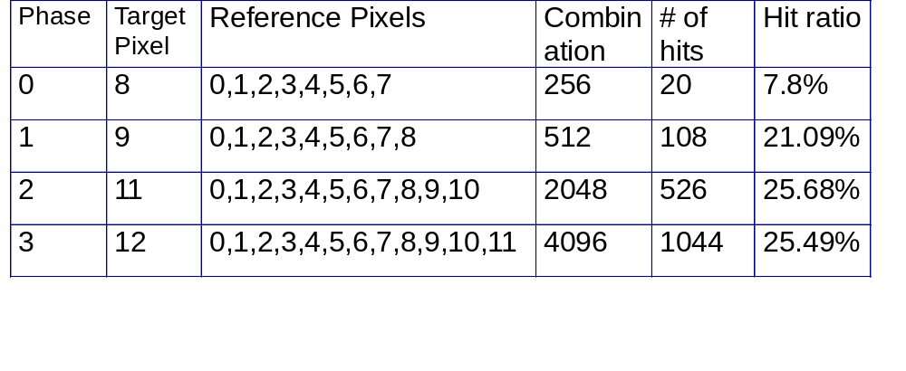
Deterministic Prediction JBIG encoder
0
1
In the default RR algorithm,
DP is fixed.
4
5
6
7
8
9
2
3
10
11
12

Slide 26
Model Template JBIG encoder
Lowest Layer
X
X
X
3 Lines Template
X
X
X
X
A
X
X
?
2 Lines Template
X
X
X
X
X
A
X
X
X
X
?
Fast, but a 5% loss in compression efficiency

Slide 27
Model Template JBIG encoder
Differential-Layer
X
X
A
X
X
A
X
X
X
X
?
X
X
?
Phase 1
Phase 0
X
X
X
X
X
X
X
X
X
X
A
X
X
A
X
X
Phase 3
Phase 2
X
X
X
X
X
X
?
X
X
?
X
X
X
X

Slide 28
Adaptive Template JBIG encoder
Template could be adaptive from (-M_{x},-M_{y}) to (M_{x},M_{y})
(0,0) means to restore back to default location
M_{x},M_{y}
2,M_{y}
1,M_{y}
0,M_{y}
-1,M_{y}
-2,M_{y}
-M_{x},M_{y}
M_{x},1
2,1
1,1
0,1
-1,1
-2,1
0,1
M_{x},0
2,0
1,0
?

Slide 29
Adaptive Template JBIG encoder
In implementation, M_{y}=0, M_{x}= 8 is recommended.
X
X
X
X
X
X
X
0
M_{x}
6
5
4
3
X
X
?
Lowest layer
X
X
X
X
X
0
M_{x}
6
5
X
X
X
X
?
X
Differential
Layer
0
X
X
M_{x}
5
4
3
X
X
?

Slide 30

Adaptive Arithmetic Coder JBIG encoder
Divide the range into 2 subdivision according p0/p1
Precision consideration
  A: coded interval
    [0x8000,0x10000]
  C: coded value
Scaling as needed (re-normalization)
In real implementation, use modified QM-coder instead of IBM’s Q-coder
1
1
L+A
1-pLPS
L+A-LSZ
C
A
L
0
0

Slide 31
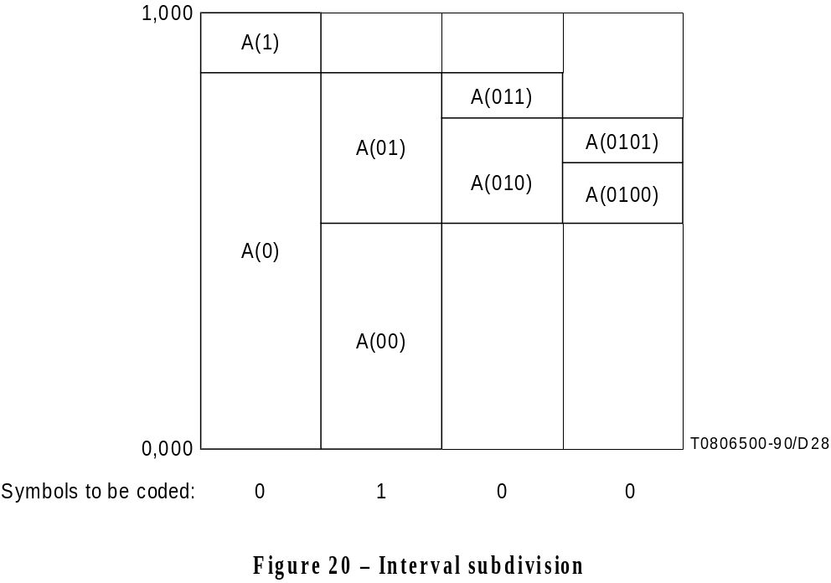
Adaptive Arithmetic Coder JBIG encoder
PIX: pixel being coded
CX: context (226 states)
TPVALUE: typical prediction
DPVALUE: deterministic prediction
SCD: stripe coded data
PIX
Arithmetic
encoder
SCD
SCD
Arithmetic
decoder
PIX
CX
CX
TPVALUE
TPVALUE
DPVALUE
DPVALUE

Slide 32
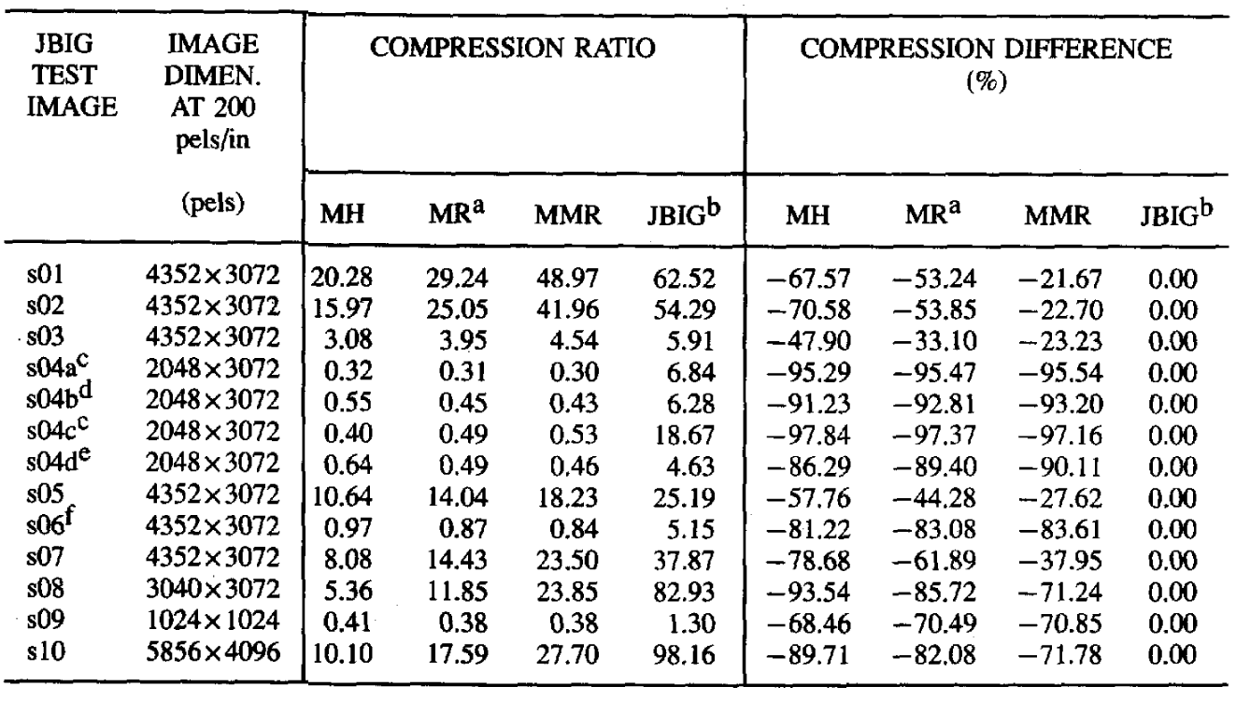
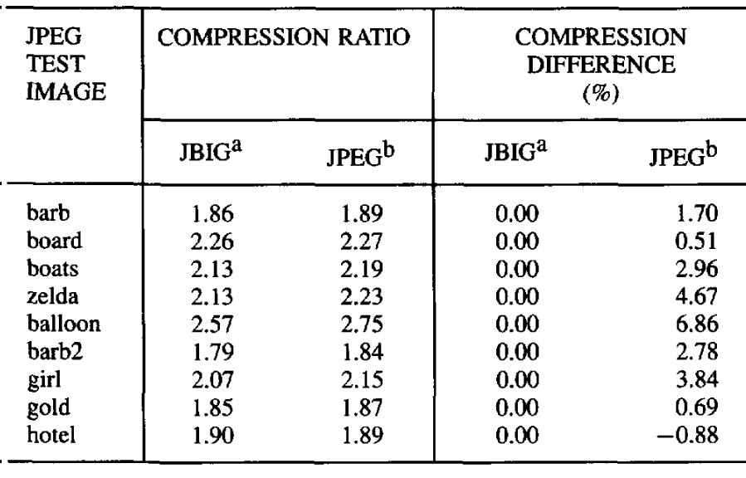
Comparison
Performance of G3 (1D),
G3 (2D), G4 and JBIG
Advantage.
  Compression ratio
  Progressive (scalability)
  also support grayscale and color image coding
Disadvantage.
  More Computation
  More Memory
PRES and general subsampling

Slide 33
Applications
MPEG-4!!!
Soft-Modem!!!

Slide 34
JBIG2
JBIG is short for the 'Joint Bi-level Image experts Group'.
The official page: http://www.jbig.org.
The 'official' title of the committee is ‘ISO/IEC JTC1 SC29 Working Group 1’.

Slide 35
ISO/IEC 14492 (ITU-T T.88)
Informally referred to as “JBIG2”
ISO 14492: Information technology –Lossy/Lossless coding of bi-level images
  ISO 14492/AMD1: Encoder
  ISO 14492/AMD2: Extension of Adaptive Template for halftone coding
  ISO 14492/AMD3: Verification test procedure for JBIG2 encoder/decoder

Slide 36
JBIG2
Designed for the Internet.
The key to the JBIG2 is soft pattern matching, which is a method for making use of the information in previously encountered characters without risking the introduction of character substitution errors that is inherent in the use of OCR.
An universal compression method to provide optimal compression capabilities
  for both lossless and lossy compression
  to arbitrary scanned images (containing both text and halftone images)
  with scanning rate from 100 to 800 dots/in.
A toolkit instead of a baseline implementation for fitting different application requirements

Slide 37
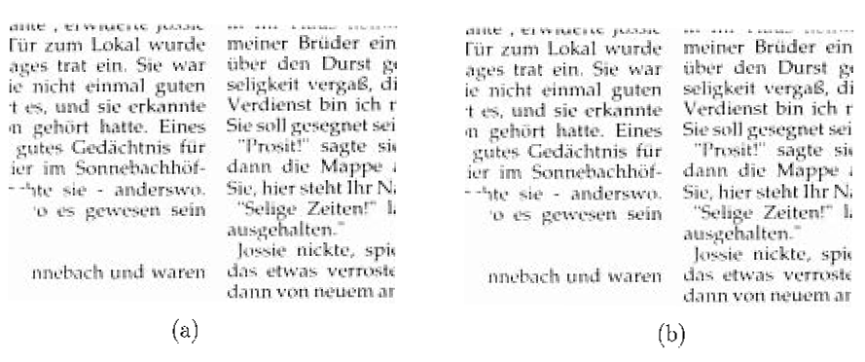
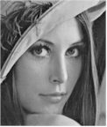
Features
Lossy (via pre-processing)
Quality progressive coding
Content progressive coding
Model based coding (text, halftone, generic)
Operational modes with different computational requirements
original
lossy coded
2.halftone
document
1.text

3.generic


Slide 38
Technical description
Efficient multi-page processing
Page layout and component description
  Image data segment: appearance of a page.
  Dictionary data segment: elements that make up the page.
Header and control
  Sequencing mode (streaming)
  Random access mode (archiving)
MQ-coder with fewer (94) states is used.

Slide 39
Basic ideas of text image coding
Image is first segmented into individual marks (connected components of black pixels)
The resulting set of marks is partitioned into equivalence classes, with each class containing all occurrences of a single letter, digit or punctuation symbol.
The image is then composed by coding a representative token mark from each class, the position of each mark of the matching class, and finally the resulting error signal between each mark and its class token.
The classes and the representative tokens are adaptively updated as the marks in the image are determined and coded.
Each class token is compressed using a statistically based, arithmetic coding model that can code classes independently of each other.

Slide 40
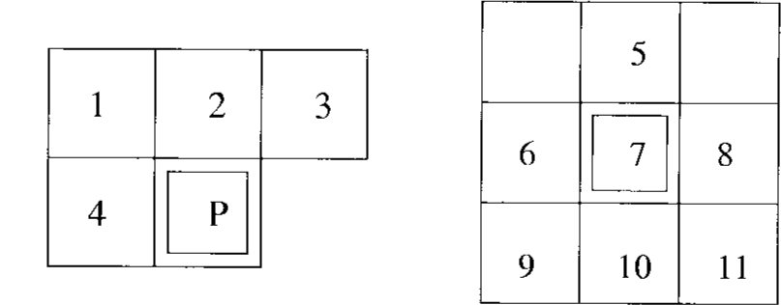
Text image coding
Based on pattern matching
  Pattern matching and substitution (lossy)
  Soft pattern matching (lossless)
Pixel block data (offset, index)
  Bitwise
  Huffman coding
Numerical residual data (prediction errors)
  Multi-alphabet arithmetic coding
  Huffman coding
Basic coding of bitmaps
  JBIG1
  MMR
AT
AT

Slide 41
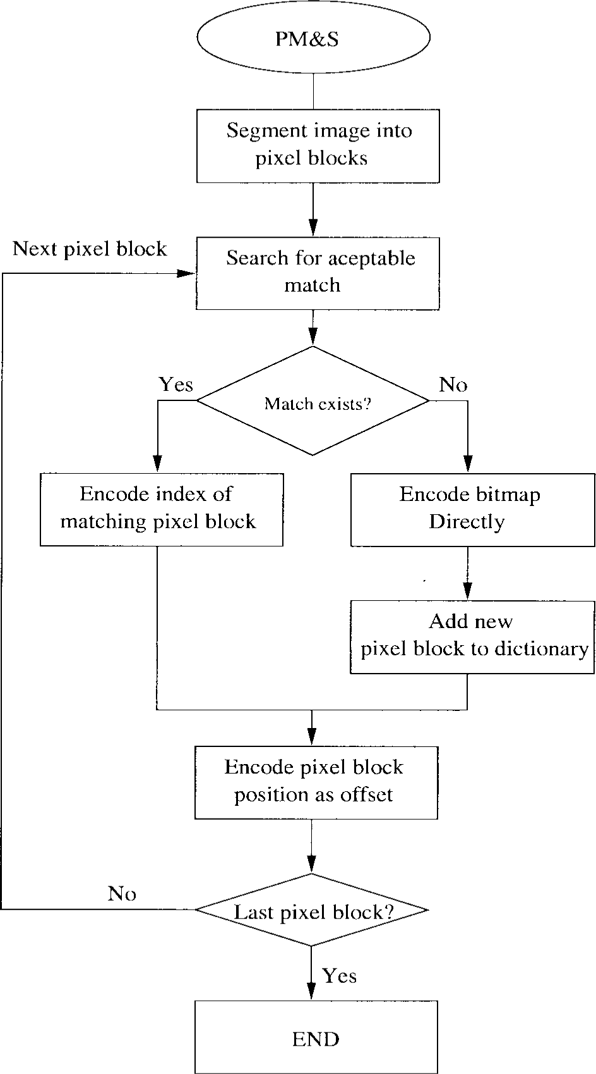
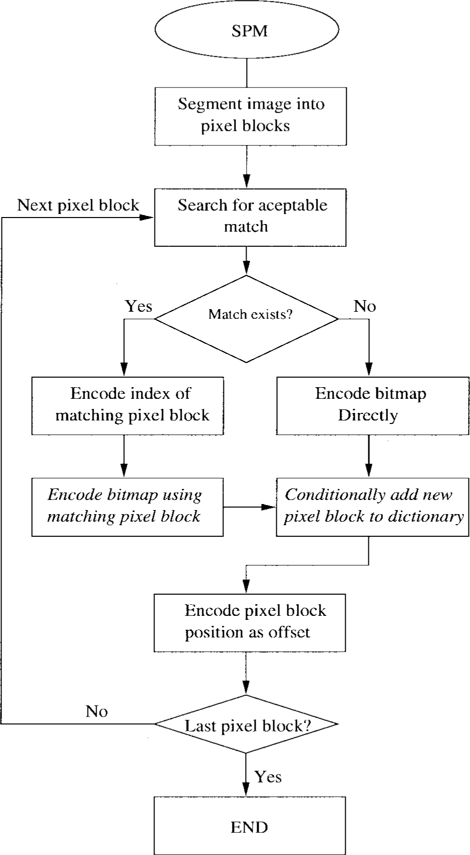

Slide 42
Halftones
Context-based arithmetic coding as in JBIG1, but 16 template pixels including 4 adaptive pixels instead.
Convert all m×n pixel blocks into grayscale pixel samples, bitplane will be coded using JBIG1.
Provide better quality of halftone with an angled period.
A₄
X
X
X
A₃
X
X
X
X
A₂
X
X
X
X
X
A₁
X
X
X
X
X
A₁
X
X
X
X
?
X
X
X
?
16 pixel template
13 pixel template

Slide 43
Further improvement
Quantization of offsets (1%)
Noise removal and smoothing (10%)
  E.g. remove single protruding pixels
Bit flipping

Slide 44
Performance
About 3~5 times smaller than Group 4/MMR, 2~4 times smaller than JBIG1 for lossless compression of bi-level images.
Another compression factor of 3~10 for lossy mode, without noticeable visual differences.

Slide 45
Reading assignment
Mandatory
  Paul. G. Howard et.al, “The emerging JBIG2 standard,” IEEE trans on circuits and systems for video technology, Nov 1999.
Suggested
  Ronald B. Arps and Thomas K. Truong, “Comparison of International standards for lossless still image compression,” Proc. of the IEEE, June 1994.

Slide 46
Homework
2. Consider a 16x16 binary image with the same number of black and white pixels inside (128 for each). What block pattern will make JBIG-1 encoder perform best? What will be the worst?
In the worse case, can you design a customized RR/DP/AT to improve the coding performance?

